Slide 1
Unit-2 Web scrapping and its analytics
By,
Disha D N
Assistant Professor II
Department of AIML
NMAMIT

Slide 2
Contents
Introduction to BeautifulSoup()
find() and find_all() methods
Beautifulsoup() objects
Navigating Trees
Regular expression
Writing web crawlers : Single domain
Crawling across the internet
Web crawling models: planning and defining objects
Dealing with different website layouts
Structuring crawlers
Crawling sites through search
Crawling sites through links

Slide 3
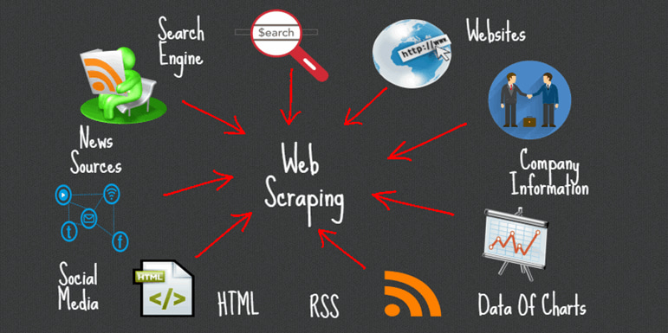
What is web scrapping?
Web scraping is the process of extracting data from websites automatically using a script or program. It involves accessing the HTML code of a webpage, parsing the code to extract the desired information, and then storing or using that information for various purposes.

Slide 4
Different web scrapping techniques
Manual Scraping:
This involves manually inspecting the webpage's HTML code and copying the desired data by hand. It's suitable for simple one-time tasks but can be time-consuming and not practical for large-scale scraping.
Regular Expressions:
Regular expressions (regex) can be used to extract specific patterns from HTML code. It can be effective for simple data extraction tasks but becomes more challenging as the complexity of the HTML structure increases.

Slide 5
BeautifulSoup:
BeautifulSoup is a popular Python library for web scraping. It provides a simple API to navigate and extract data from HTML and XML documents. It handles parsing and traversing the HTML tree structure, making it easier to locate and extract desired elements.
Scrapy:
Scrapy is a powerful Python framework specifically designed for web scraping. It offers more advanced features like asynchronous requests, handling pagination, and handling complex website structures. Scrapy provides a robust framework for building scalable and efficient web scraping applications.
Selenium:
Selenium is a tool commonly used for automating web browsers. It can be useful when dealing with websites that heavily rely on JavaScript or require interactions like clicking buttons or filling out forms. Selenium can programmatically control a browser and extract data from dynamically generated content.
APIs:
Some websites provide APIs (Application Programming Interfaces) that allow developers to access and retrieve data in a structured format. Instead of scraping HTML, you can directly request data from the API endpoint and receive the response in JSON or XML format. APIs provide a more reliable and efficient way to access website data if available.
Headless Browsers:
Headless browsers like Puppeteer or PhantomJS allow you to automate web scraping by running a browser in the background without a graphical user interface. They enable you to interact with web pages, execute JavaScript, and extract data.

Slide 6

Introduction to Beautifulsoup()
BeautifulSoup is a Python library used for web scraping and parsing HTML and XML documents. It provides a convenient way to extract data from web pages by navigating and searching through the HTML structure.
When working with web scraping, the first step is to retrieve the HTML content of a web page. This can be done using various libraries such as requests or urllib. Once we have obtained the HTML content, we can pass it to BeautifulSoup for parsing and data extraction.
To start using BeautifulSoup, first need to import it into Python script:

Slide 7
Next we can create BeautifulSoup object by passing the HTML content and specifying the parser. BeautifulSoup supports different parsers, such as the built-in Python parser or external libraries like lxml or html5lib.
Consider the following example:
html_content = """ <html>
<head>
<title>Example</title>
</head> <body>
<p class="paragraph">This is a paragraph.</p>
<ul> <li>Item 1</li>
<li>Item 2</li> </ul> </body> </html> """
soup = BeautifulSoup(html_content, 'html.parser’)
Once wehave created the BeautifulSoup object, you can start navigating and searching the HTML structure. BeautifulSoup provides various methods and attributes to access different elements and data within the HTML document.

Slide 8
To Access the title of the HTML document, we can use ‘title’ attribute
title = soup.title
print(title.text) # Output: Example
To access the contents of a specific tag, we can use the tag name as an attribute
paragraph = soup.p
print(paragraph.text) # Output: This is a paragraph.

Slide 9
Navigating the Parse TREE
When working with BeautifulSoup, the HTML or XML document is converted into a parse tree, which is a hierarchical representation of the document's structure. This parse tree allows you to navigate and search through the document to access specific elements and data.
Beautiful Soup provides several methods and properties to navigate and search the parse tree. Some commonly used methods include:
1. Tag navigation: We can access elements based on their tag names. For example, to access the first p tag in the document, we can use the find() method:
Example 1: paragraph = soup.find(‘p’)
If we want to find all the ‘p’ tags, we can use the find_all() method
Example 2: paragraphs = soup.find_all('p')

Slide 10
2. Parent and Sibling navigation: BeautifulSoup allows to access the parent, previous sibling, and next sibling of an element. The parent attribute gives the direct parent of an element, previous_sibling gives the element before the current one, and next_sibling gives the element after the current one.
Example 3:
parent_element = element.parent
previous_sibling = element.previous_sibling
next_sibling = element.next_sibling

Slide 11
3. Child navigation: We can access the direct children of an element using the children attribute. This returns an iterable containing all the child elements. Additionally, we can use the descendants attribute to access all the descendants of an element, including nested elements.
Example 4:
for child in element.children:
print(child.text)
4. Searching by CSS class and attributes: BeautifulSoup allows you to search for elements based on their CSS classes or attributes. You can use the class_ parameter to search for elements with a specific CSS class:
Example 5:
elements = soup.find_all('div', class_='my-class')

Slide 12

Find() method
The find() method in BeautifulSoup is used to search for the first occurrence of an element that matches a specific criteria within the parse tree. It allows you to locate elements based on various attributes, tag names, CSS classes, or even custom functions.
Syntax is as follows:
Parameters in detail:
name: This parameter specifies the tag name of the element you are searching for. It can be a string or a list of strings to match multiple tag names. For example, name='div' will search for the first <div> tag.
attrs: This parameter allows you to search for elements based on their attributes. You can pass a dictionary of attribute-value pairs to search for elements with specific attributes. For example, attrs={'class': 'my-class', 'id': 'my-id'} will search for the first element that has the class 'my-class' and the id 'my-id'.

Slide 13
recursive: By default, recursive=True, the find() method searches for elements recursively within the parse tree. This means it searches for elements within the current element and its descendants. Setting recursive=False restricts the search to only the direct children of the current element.
string: This parameter allows you to search for elements that contain a specific string of text. For example, string='example' will search for the first element that contains the text 'example’
**kwargs: Additional keyword arguments can be passed to the find() method to search for elements based on any attribute-value pair. For example, find(data='value') will search for the first element that has a data attribute with the value 'value’.
NOTE: The find() method returns the first matching element that satisfies the specified criteria. If no element is found, it returns None.

Slide 14
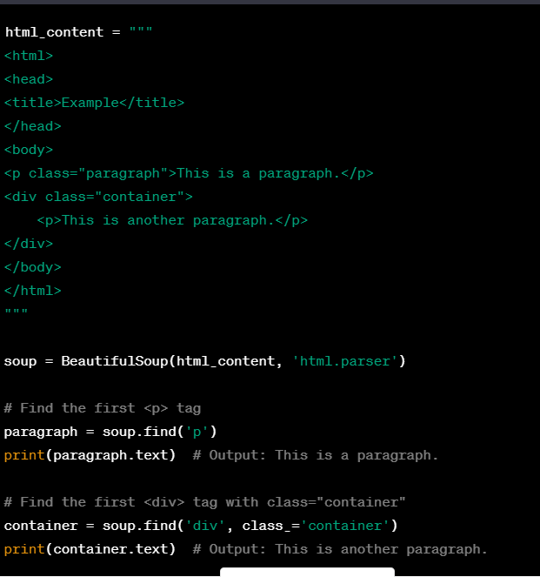
Example: Find() method

Slide 15
Find_all() method
The find_all() method in BeautifulSoup is used to search for all occurrences of elements that match a specific criteria within the parse tree. It allows you to locate elements based on various attributes, tag names, CSS classes, or even custom functions.
Syntax will be as follows:
Parameters are as follows:
name: This parameter specifies the tag name of the elements you are searching for. It can be a string or a list of strings to match multiple tag names. For example, name='div' will search for all <div> tags.

Slide 16
attrs: This parameter allows you to search for elements based on their attributes. You can pass a dictionary of attribute-value pairs to search for elements with specific attributes. For example, attrs={'class': 'my-class', 'id': 'my-id'} will search for elements that have the class 'my-class' and the id 'my-id’.
recursive: By default, recursive=True, the find_all() method searches for elements recursively within the parse tree. This means it searches for elements within the current element and its descendants. Setting recursive=False restricts the search to only the direct children of the current element.
string: This parameter allows you to search for elements that contain a specific string of text. For example, string='example' will search for elements that contain the text 'example’.
limit: This parameter allows you to limit the number of elements returned by the find_all() method. By default, it returns all matching elements. Setting limit=n will return at most n elements.
**kwargs: Additional keyword arguments can be passed to the find_all() method to search for elements based on any attribute-value pair. For example, find_all(data='value') will search for elements that have a data attribute with the value 'value’.

Slide 17
Example find_all()
html_content = """ <html> <head> <title>Example</title> </head> <body> <p class="paragraph">This is a paragraph.</p> <div class="container"> <p>This is another paragraph.</p> </div> </body> </html> """
soup = BeautifulSoup(html_content, 'html.parser’)
# Find all <p> tags paragraphs = soup.find_all('p’)
for paragraph in paragraphs:
print(paragraph.text)
# Find all <div> tags with class="container"
containers = soup.find_all('div', class_='container’)
for container in containers: print(container.text)

Slide 18
Beautifulsoup objects
BeautifulSoup objects are the main interface provided by the BeautifulSoup library. They represent the parsed HTML or XML document and provide a set of methods and attributes to navigate, search, and manipulate the document's structure.
When we create a BeautifulSoup object, we need to pass the HTML or XML content as a string and specify the parser to use. BeautifulSoup supports different parsers, including the built-in Python parser ('html.parser'), the lxml parser ('lxml'), and the html5lib parser ('html5lib'). The parser is responsible for converting the raw document into a parse tree.

Slide 19
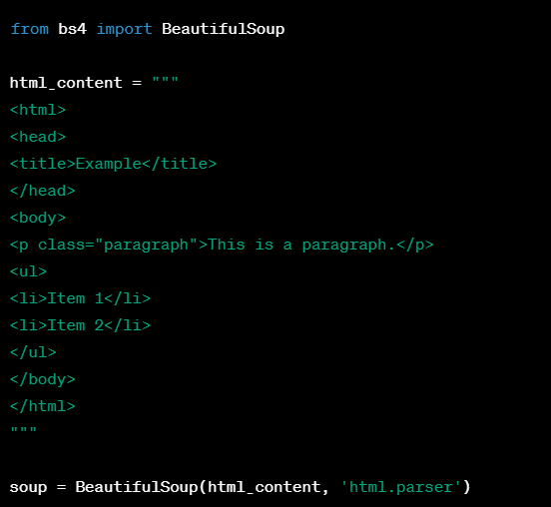
When you parse an HTML or XML document using BeautifulSoup, it creates a BeautifulSoup object that contains the entire document structure. From there, you can navigate the document tree using methods like find(), find_all(), select(), and more, to locate specific tags or elements of interest.
These methods return Tag objects or lists of Tag objects, allowing you to access their attributes, manipulate the data, or extract the text within them. You can also search for tags based on various attributes like class names, IDs, or custom attributes.

Slide 20




Once we have a BeautifulSoup object, various operations on it. Some of them are as follows:
tag: It represents an HTML or XML tag within the document. You can access tags using dot notation or by calling methods like find() or find_all().
text: It represents the text content of an element or a tag. It retrieves the combined text from an element and its descendants.
find(name, attrs, recursive, string, **kwargs): It searches for the first occurrence of an element that matches the specified criteria and returns a Tag object.
find_all(name, attrs, recursive, string, limit, **kwargs): It searches for all occurrences of elements that match the specified criteria and returns a ResultSet object, which is a list-like collection of Tag objects.

Slide 21




parent: It represents the parent element of a tag.
next_sibling and previous_sibling: They represent the next and previous siblings of a tag, respectively.
children: It provides an iterator over the direct children of a tag.
prettify(): It returns a nicely formatted string representation of the document, making it easier to read and debug.

Slide 22
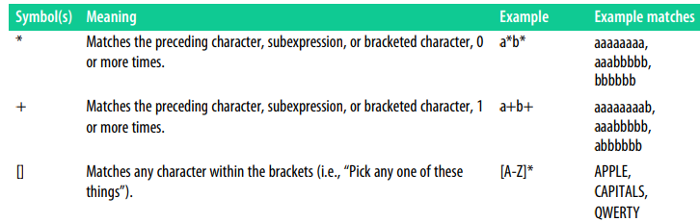
Regular expressions
Regular expressions (often abbreviated as regex or regexp) are powerful tools for pattern matching and manipulating text. A regular expression is a sequence of characters that defines a search pattern. It is commonly used in programming languages and text editors to perform various operations such as searching, matching, replacing, and extracting textual data.
Commonly used regular expressions and Symbols

Slide 23
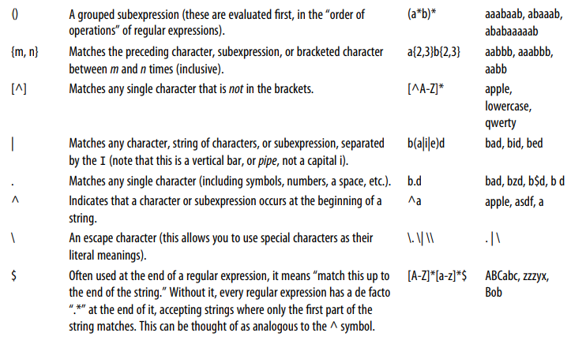

Slide 24
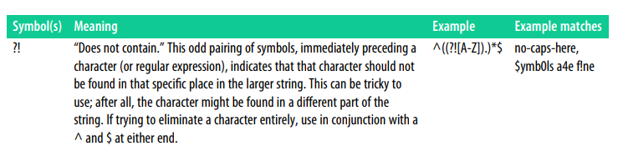

Slide 25
Web crawlers

Slide 26
Introduction to web crawlers
A web crawler, also known as a web spider, is an automated script or program used to systematically browse and index the World Wide Web. It is designed to visit websites, retrieve web pages, and extract information from them for various purposes, such as search engine indexing, data mining, or content scraping.
Purpose of web crawlers
Web crawlers are primarily used for gathering information from the web. Some common use cases include:
Search Engine Indexing: Search engines employ crawlers to discover web pages, analyze their content, and index them for retrieval in search results.
Data Mining and Research: Crawlers can be used to collect specific data from websites, such as product details, news articles, or social media posts, for analysis or research purposes.
Monitoring and Tracking: Crawlers can be used to monitor changes on websites, track prices of products, or gather information for competitive analysis.
Content Aggregation: Crawlers can be used to gather content from multiple websites and aggregate it into a single platform or service.
Link Verification: Crawlers can be used to check the validity and availability of website links.

Slide 27
Web crawling process
Seed URLs: The crawler starts with a set of initial URLs, known as seed URLs, which are typically provided manually or obtained from a predefined list or database.
HTTP Request: The crawler sends an HTTP request to the web server hosting the URL, requesting the corresponding web page.
Web Page Retrieval: The server responds with the HTML content of the web page, which the crawler then retrieves and downloads.
Parsing HTML: The crawler parses the HTML to extract links, content, and other relevant information using techniques like DOM parsing or regular expressions.
URL Frontier: The crawler maintains a queue or list of URLs to visit, known as the URL frontier. It adds newly discovered URLs to this list for subsequent crawling.
Follow Links: The crawler follows the extracted links and repeats the crawling process for each new URL encountered, expanding the scope of the crawl.
Throttling and Politeness: Crawlers often implement politeness rules and rate limits to avoid overloading servers and respect website owner's guidelines.
Data Storage: The extracted data is typically stored in a structured format or database for further analysis or processing.

Slide 28
Crawling policies and challenges
Web crawlers face several challenges and considerations:
Robots.txt: Crawlers respect the "robots.txt" file, a standard mechanism for website owners to control crawler access to their site.
Duplicate Content: Crawlers may encounter duplicate content on different URLs or follow infinite loops of links. Techniques like URL normalization and duplicate content detection are used to address this issue.
Crawl Scope: Crawlers need to define the scope and depth of the crawl, including limitations on domain, subdomains, or specific paths.
Dynamic Content: Crawlers may struggle with dynamic websites that generate content dynamically using JavaScript or require user interactions to access specific pages.
Anti-Crawling Measures: Some websites implement anti-crawling measures like CAPTCHAs, IP blocking, or session tracking to deter or block crawlers.

Slide 29
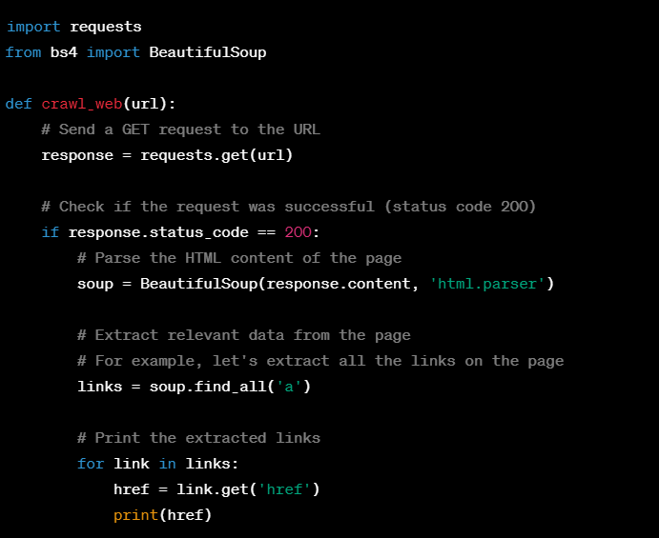
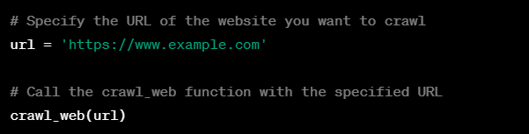
Web crawler example

Slide 30
Web crawler: To search an entire site
Web crawling to search an entire site involves systematically navigating through all the pages of a website to search for specific content or information. The goal is to explore the website in a comprehensive manner, visiting each page and searching for the desired data.
Steps involved are as follows:
Choose a starting point: Select a specific page within the website from which the crawling process will begin. This page could be the homepage or any other relevant entry point.
Send a GET request: Use an HTTP library like requests in Python to send a GET request to the chosen starting page URL. Retrieve the HTML content of the page as a response.
Parse the HTML: Utilize an HTML parser library like BeautifulSoup to parse the HTML content received from the page. This allows you to navigate and search within the HTML structure.
Search for desired content: Define the criteria for the content you want to search for within the pages. This could be specific keywords, phrases, tags, or any other relevant patterns. Use the parsed HTML to search for this content, either by searching for specific tags, examining the text, or applying regular expressions.
Extract relevant information: If the desired content is found, you can extract additional information related to it. This could include extracting metadata, associated links, or any other data that might be useful.
Follow links: Identify all the links on the current page, and add them to a queue or list to visit later. Ensure that these links are complete URLs by resolving any relative URLs with the base URL of the website.

Slide 31
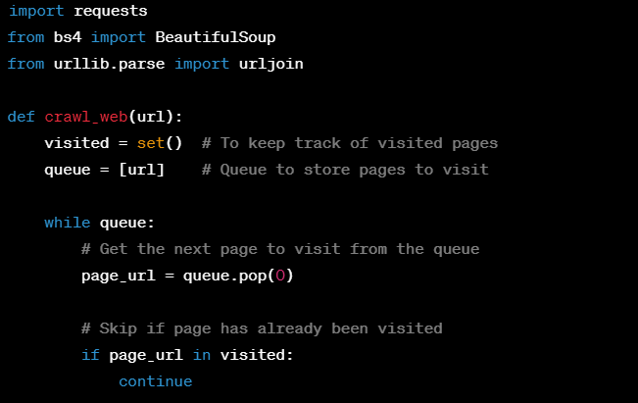
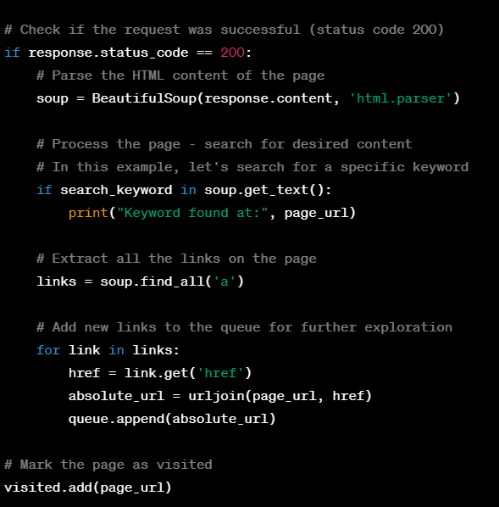
Example code

Slide 32
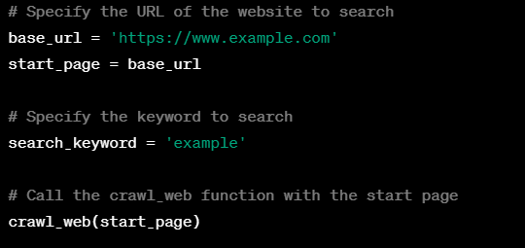

Slide 33
Web crawling for internet
Performing crawling across the entire internet is an enormous task and requires significant resources and infrastructure. Generally, web crawling is focused on specific domains or websites rather than attempting to crawl the entire internet.
It involves the process of getting external links during crawling process
Steps to get external links can be as follows:
Seed URLs: Select initial seed URLs that belong to the domain you want to crawl. These URLs can be the homepage or any other relevant pages within the domain.
Crawling and Parsing: Start crawling the seed URLs by sending HTTP requests and retrieving the corresponding web pages. Parse the HTML content of the web pages using tools like BeautifulSoup to extract relevant information.
Link Extraction: Identify and extract the links from the parsed content. This can be done by searching for anchor tags (<a> tags) in the HTML that contain the href attribute, which indicates the URL of the link.

Slide 34
Filtering Internal and External Links: Differentiate between internal and external links. Internal links refer to URLs within the same domain or website, while external links point to URLs outside of the domain being crawled.
Handling External Links: Once you have identified external links, you can choose how to handle them based on your crawling requirements. Here are a few common options:
Ignore: You may decide to ignore external links and focus solely on crawling and extracting data from the current domain.
Follow: You may choose to follow external links and include them in the crawling process to expand your scope beyond the initial domain.
Record: You may record the external links for analysis or further processing without immediately crawling them.
Recursive Crawling: If you decide to follow external links, you can recursively perform the crawling process on those links as well. This allows you to crawl multiple domains and expand your reach across the internet.

Slide 35
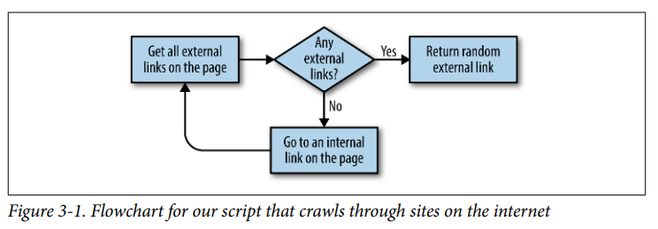
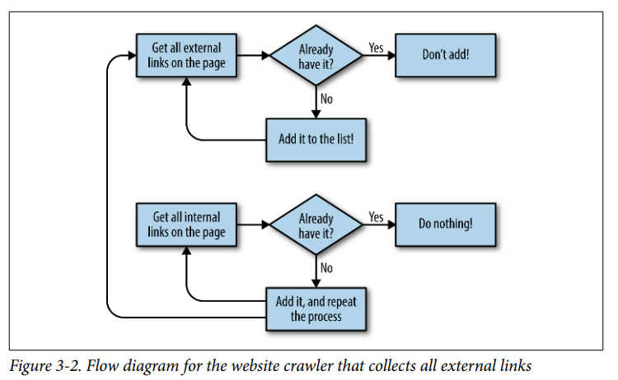

Slide 36
Planning and defining objects
One common trap of web scraping is defining the data that you want to collect based entirely on what’s available in front of your eyes. For instance, if you want to collect product data, you may first look at a clothing store and decide that each product you scrape needs to have the following fields:
• Product name
• Price
• Description
• Sizes
• Colors
• Fabric type
• Customer rating

Slide 37
Looking at another website, you find that it has SKUs (stock keeping units, used to track and order items) listed on the page. You definitely want to collect that data as well, even if it doesn’t appear on the first site! You add this field:
• Item SKU
Although clothing may be a great start, you also want to make sure you can extend this crawler to other types of products. You start perusing product sections of other websites and decide you also need to collect this information:
• Hardcover/Paperback
• Matte/Glossy print
• Number of customer reviews
• Link to manufacturer
Clearly, this is an unsustainable approach. Simply adding attributes to your product type every time you see a new piece of information on a website will lead to far too many fields to keep track of. Not only that, but every time you scrape a new website, you’ll be forced to perform a detailed analysis of the fields the website has and the fields you’ve accumulated so far, and potentially add new fields

Slide 38
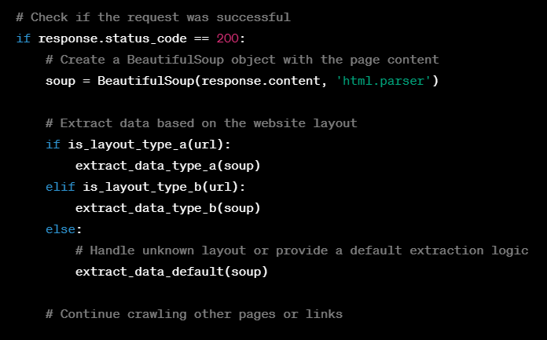
Dealing with different website layouts
When dealing with different website layouts during web crawling, it's important to adapt your crawler to handle the specific structures and elements of each website.
Simple approach would be writing a separate crawlers for different layouts
Example:

Slide 39
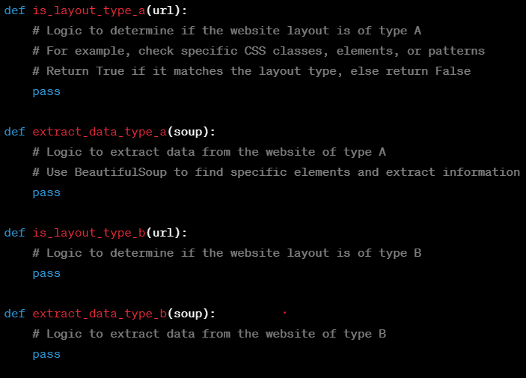
These things can also be modified by search function, search through links function

